Slide 1

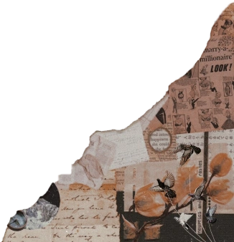



The story of
Anaushey Batool

Slide 2
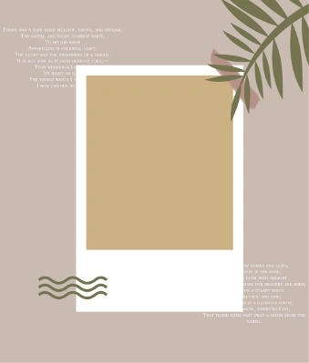
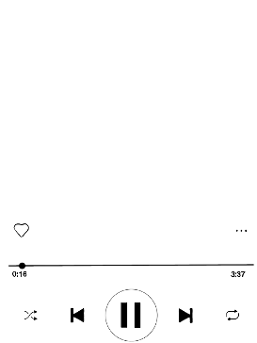
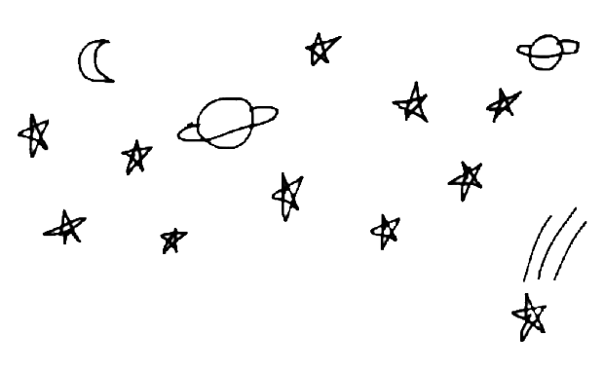
Born on 11th of August 2003, she is a leo through & through.
Her birthplace is sukkur but she was raised in Islamabad.

Slide 3




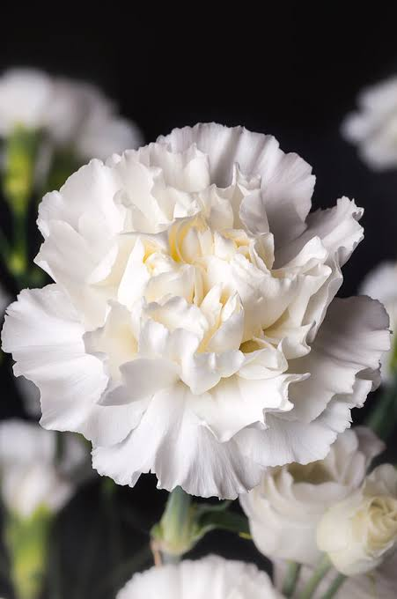
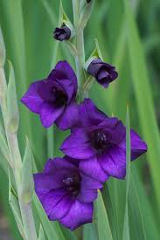

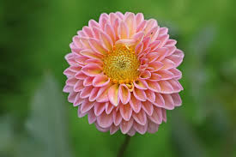
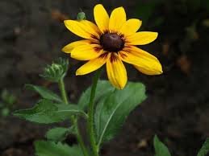
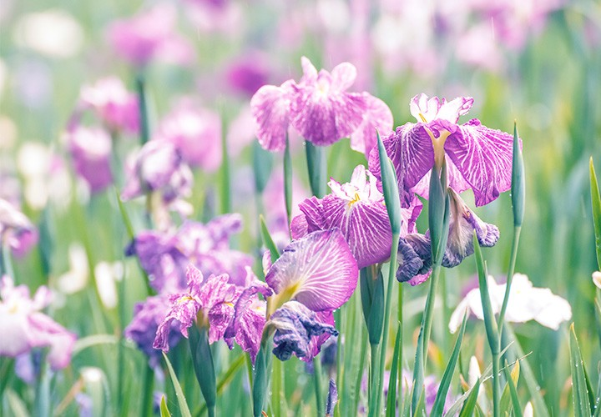

La Famille
She’s an aspirant floriograph
Mother
Father
Anaushey Shafquat Mashal Amjad

Slide 4



She studied at The City School
Topped at all academies she went to
Joined a photoshop summer camp but ended up leaving because of chicken pox
Aspiring CSS Officer
Has read most of the classics
Favorite poets are Edgar Allen Poe and Emily Dickenson
Is said to come for Captain America’s optimism brand.

Slide 5



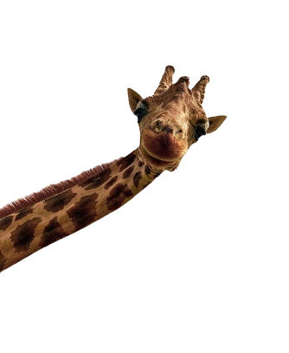

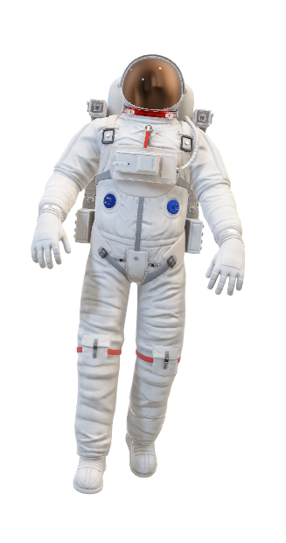
She loves Space and Universe and Chocolates and rainy days and Petrichor and magic and animals from afar and peace.

Slide 6

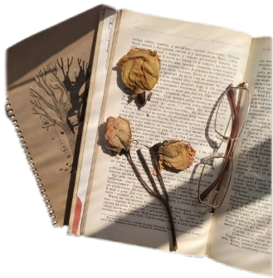
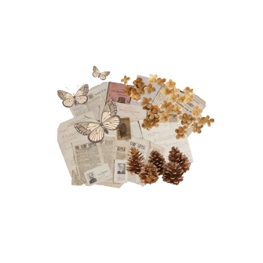
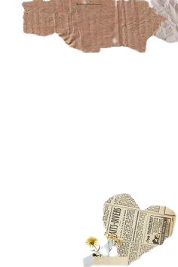

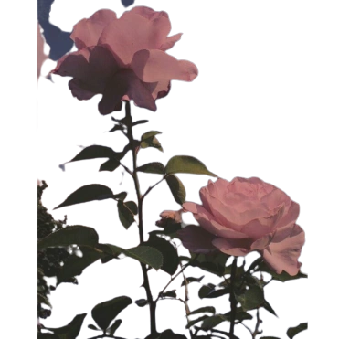
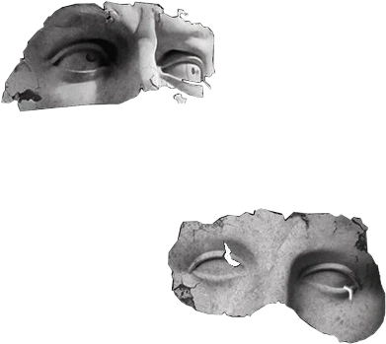
She grew up with books
Starting with “a rainy day with barbie” she came to see reading for the magic it was and now she reads diverse genres and finds strength in beings unseen.
She is passionate about biotech and cloning and pulls all nighters trying to figure out the minds of killers.
She finds comfort in words and strength there too and she loves art that makes sense to her.

Slide 7
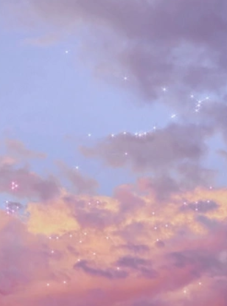
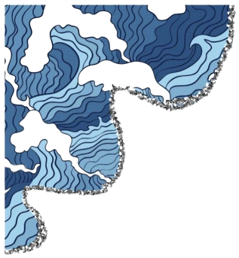
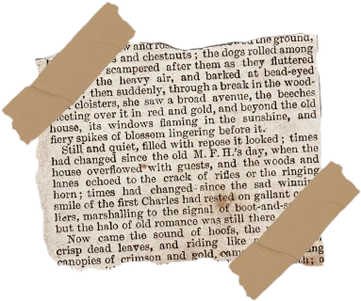


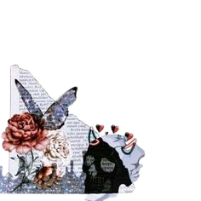
K-dramas and K-pop are her calming areas
The Ocean is where she feels at home
Serial killers and killers in general intrigue her
Anything sweet makes her happy so she can be easily kidnapped but thankfully she is strong…
Anyways besides wanting to go to Korea, she wants to be a published writer.

Slide 8
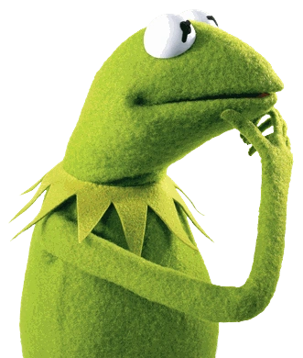

Slide 9
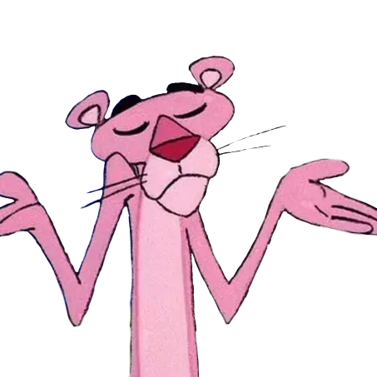

Slide 10

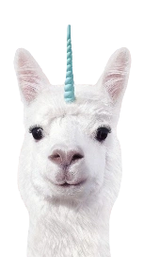

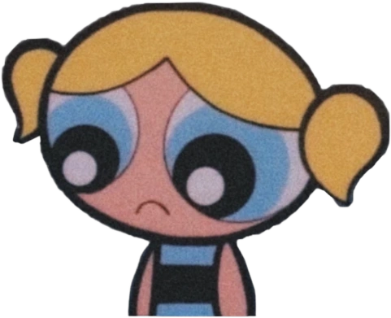
Looks like that’ll be all
It’s okay here’s a llama

Slide 11
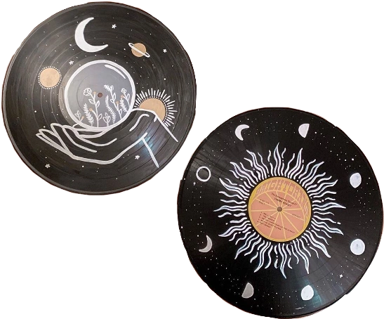
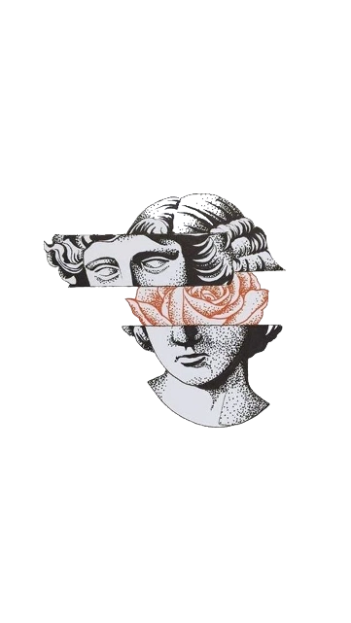
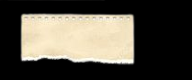


she hopes you make good choices and stay safe out there
and like she lives to see the snow and her family happy,
she hopes you find something too.

